Slide 1

Tool4U
TE MINI-PROJECT
SHAH & ANCHOR KUTCHHI ENGINEERING COLLEGE
CHEMBUR, MUMBAI-400088.
2021-2022
DEPARTMENT OF INFORMATION TECHNOLOGY
ready to use tools…
Under the Guidance of
Project Guide: Mrs. Swati Gajbhiye

Slide 2


TEAM MEMBERS
Chirag Dodia TE5-08
Bhoomi Parmar TE5-32
Jay Sheth
TE5-49
Rahul Panchal
TE6-34

Slide 3
Problem Statement
Productivity is never an accident. It is always the result of a commitment to excellence, intelligent planning, and consistent effort.
We would like to add another element that is helping individuals to be more productive is – productivity apps.
As the times have become a little too much competitive, it makes sense to take help from productivity tools available in the market.
Finding office work tools like image editors, resume/certificate makers, online is a tedious job. Hence we provide multiple office work tools at one stop.

Slide 4
Introduction
Here you have a list of online productive tools to use.
Every tool has a unique feature.
Our website provides convenient way to use these tools.
We provide these tools at low prices.

Slide 5

“TOOL4U”
A Website that Provides Users to Make Certificates and Resume using Different Templates layouts easily and conveniently.

Slide 6
Content Pages
Resume maker
Create instant and attractive resumes easily using our given templates.
Certificate maker
Use our pre-designed templates to create your own certificates within no time.
Image editor
Upload your photos and edit it with our image editing tools in a moment.
Miscelleneous
Contains different kins of free day to day tools

Slide 7
Literature Survey
Sr No. | Title of the Paper | Author of the paper | Published year | Inference
1 | Automatic Resume Generator | Harsha B Aladi | 2011 | In this paper, it says there is no need for developers to develop the application from scratch instead uses the APIs which requires less effort and fewer resources comparatively, can be developed independently without the need of team of resources which was impossible to do alone before without team resource
2 | Automated Batch Certificate Generation and Verification System | Ahmed Dalhatu Yusuf Moussa Mahamat Boukar Shahriar Shamiluulu | 2018 | An application called Automated Batch Certificate Generation and Verification System ABCGVS is developed based on the client-server technology. This technique is also used in many other works. Certificate verification process is inescapable in many institutions as students are issued admissions and grants in view of the certificate. The main purpose of this research work is to present a system that can be used in many institutions for generating and verifying a certificate.

Slide 8
Sr No. | Title of the Paper | Author of the paper | Published year | Inference
3 | IEEE ResumeLab— A suite of career management tools | J. Patrick Donohoe | 2019 | The resume builder provides hints on what sections should be included, how to order sections, how to promote experience, and various ways to style your resume. The portfolio builder helps you create an online gallery of your work that can be downloaded as a zipped file.
4 | Web Application for Screening Resume | Sujit Amin , Nikita Jayakar , Sonia Sunny , Pheba Babu , M.Kiruthika , Ambarish Gurjar | 2008 | This paper focuses majorly on the design of the web application which will be used to screen resumes (Curriculum Vitae) for a particular job posting. This system will definitely aid the recruiters to filter out the most prospective candidates based on their resumes for further rounds in the hiring process.

Slide 9
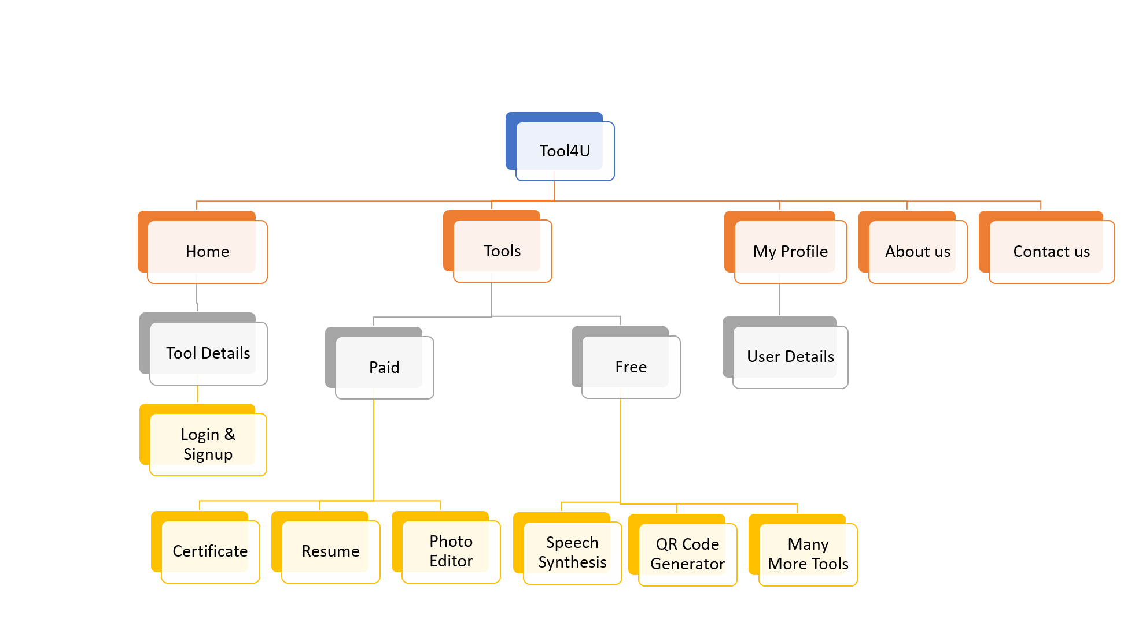
FLOWCHART

Slide 10
Languages used
HTML
CSS
JS

Slide 11
Database used
We have selected to use MongoDB as our database for this project.
MongoDB is a document-oriented NoSQL database used for high volume data storage.
We will store our user’s login credentials in our database.
MongoDB

Slide 12
Future scope
We can add more complex tools to our project for eg- Video Editor.
Start membership-based pricing.
Add more payment options.

Slide 13
Conclusion
The online resume builder and all the other tools mentioned is one of the most fantastic systems for the people who are either freshers in their domain or if they don’t have enough idea about the resume or other tools or don’t have enough time to create the resumes etc of good designs or patterns, then this platform is a very productive place for them.

Slide 14
References
Automatic Resume Generator, Harsha B Aladi,2011 IEEE.
Automated Batch Certificate Generation and Verification System, Ahmed Dalhatu, Yusuf, Moussa Mahamat Boukar, Shahriar Shamiluulu, 2018 IEEE.
IEEE Resume Lab— A suite of career management tools, J. Patrick Donohoe.2019 IEEE.
Web Application for Screening Resume, Sujit Amin , Nikita Jayakar , Sonia Sunny , Pheba Babu , M.Kiruthika , Ambarish Gurjar ,2008 IEEE.

Slide 15
Thank you

